Slide 1
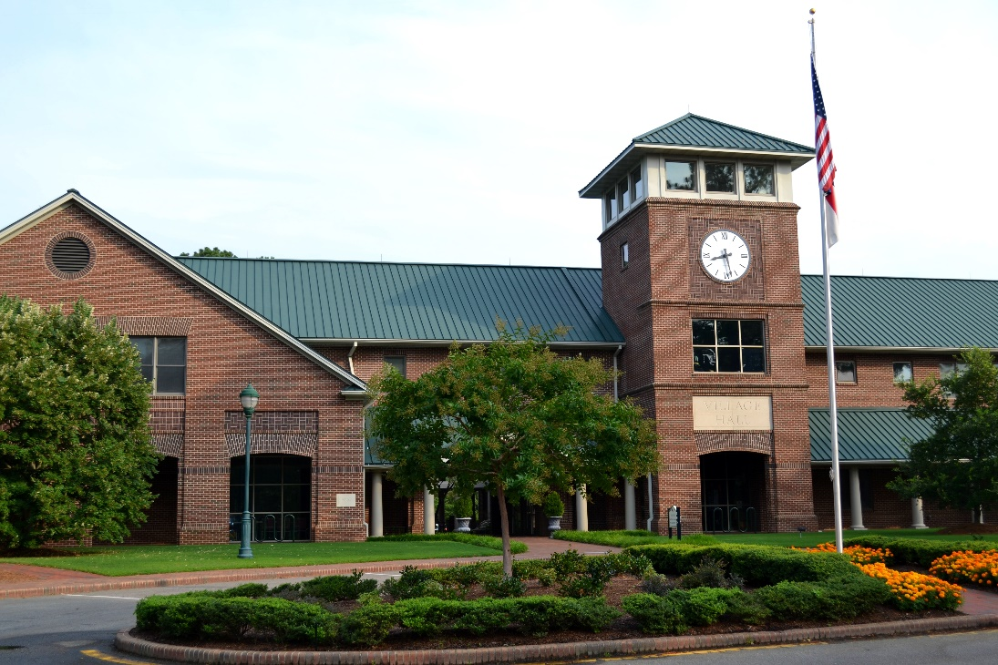
FY 2016 Village of Pinehurst
Strategic Plan Status Update As of June 30, 2016

Slide 2
FY 2016 Strategic Plan Status Update
Table of Contents
Village Council 3
Strategic objectives by balanced scorecard perspective 4
Year end status of FY 2016 initiatives 5
FY 2016 carryforward initiatives 6
Strategic initiatives completed 7
2

Slide 3
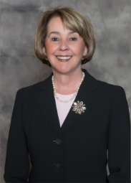
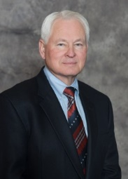
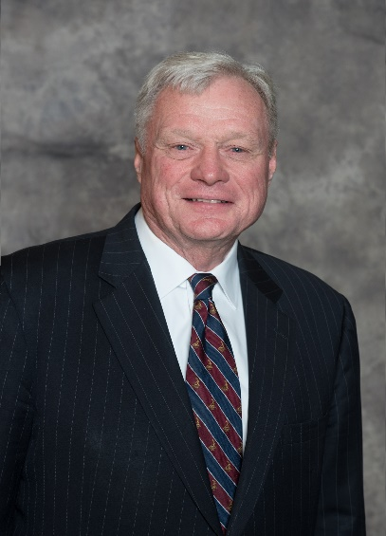
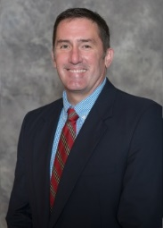
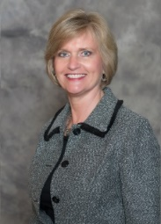
FY 2016 Strategic Plan Status Update
Village Council
Nancy Fiorillo,
Mayor
John Cashion,
Mayor ProTem
John Bouldry,
Treasurer
Clark Campbell,
Councilmember
Claire Berggren,
Councilmember
3

Slide 4
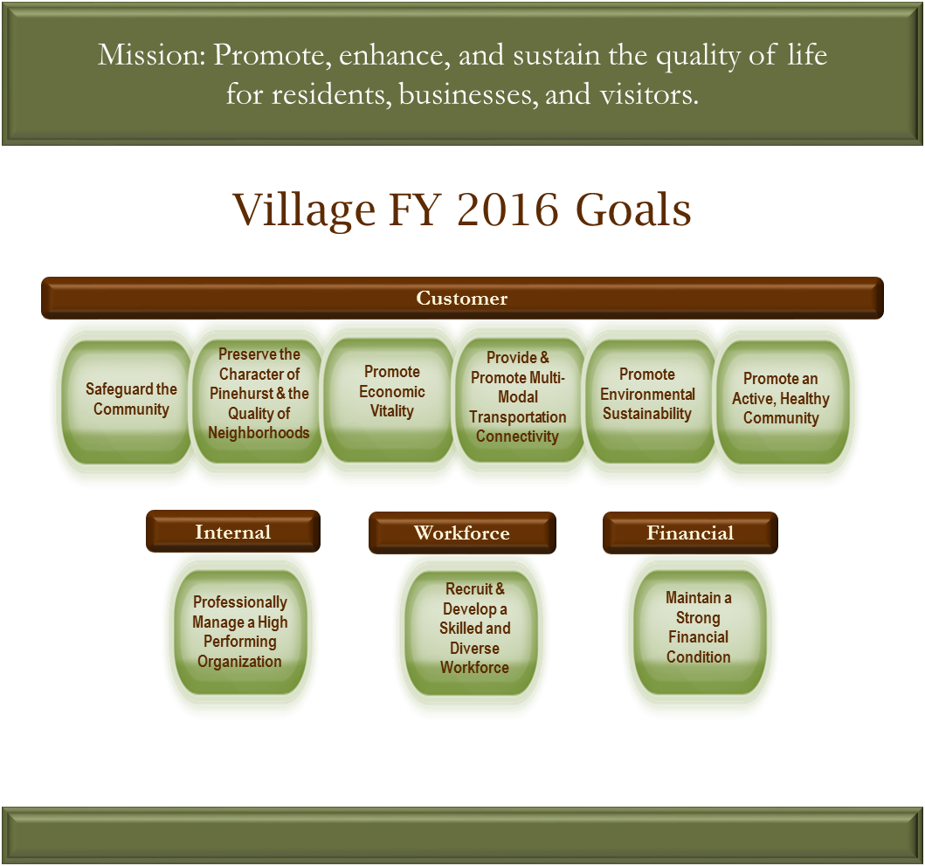
FY 2016 Strategic Plan Status Update
Strategic Objectives by Balanced Scorecard Perspective
History, Charm, & Southern Hospitality
4

Slide 5
FY 2016 Strategic Plan Status Update
Year End Status of FY 2016 Initiatives
The table below indicates the status of Initiative Action Plans (IAPs) at June 30, 2016:
Initiative Action Plan Status | # of IAPs at 06/30/16
Completed | 27
In progress and will be carried forward to FY 2017 | 6
Eliminated | 4
Total | 37
5

Slide 6
FY 2016 Strategic Plan Status Update
FY 2016 Carryforward Initiatives
Six (6) initiatives will be carried forward to FY 2017:
Initiative Action Plan | Expected Completion Date
Review key processes annually | Completed in July 2016
Grounds maintenance BIRDIE | March 31, 2017
Midland Road corridor study | December 31, 2016
Review and revise the in-house TOPS training program | September 30, 2016
Evaluate the use of solar energy | December 31, 2016
Redevelop the PS complex | December 31, 2016
6

Slide 7
FY 2016 Strategic Plan Status Update
Strategic Initiatives Completed in FY 2016
Goal | Strategic Objective | Completed Initiative Action Plans (IAPs)
Safeguard the Community | Deliver effective public safety services | Expand traffic pre-emption program to additional intersections in Village limits
 |  | Achieve national accreditation in the Fire Department
 |  | Evaluate alternative methods to proactively investigate and deter crime (BIRDIE)
Preserve the Character of Pinehurst & the Quality of Neighborhoods | Maintain a high level of overall appearance of Pinehurst public spaces | n/a
 | Achieve a high level of compliance with Village codes and ordinances | Evaluate the code enforcement process (BIRDIE) (PY carryforward)
Promote Economic Opportunity | Support economic and business development to meet the needs of Pinehurst residents and visitors | Support Pinehurst businesses through collaboration with Pinehurst Business Partners
 |  | Incrementally expand the Village Center into Village Place/Rattlesnake Corridor
7

Slide 8
FY 2016 Strategic Plan Status Update
Strategic Initiatives Completed in FY 2016
Goal | Strategic Objective | Completed Initiative Action Plans (IAPs)
Provide & promote multi-modal transportation connectivity | Provide a safe and well-maintained network of streets, sidewalks, greenways, and bike paths | Install sidewalks and/or greenways according to the Pedestrian Master Plan
 | Provide for efficient traffic flow with minimal congestion | Make intersection improvements at McKenzie Rd and Hwy 5 and Barrett Rd and Hwy 5
Promote environmental sustainability | Conserve natural resources | n/a
Promote an active, healthy community | Provide adequate recreational facilities | Develop a comprehensive recommendation for a new Community Center Facility
 |  | Develop Rassie Wicker Park facilities
 | Provide recreation programs and leisure activities for all ages | Establish a P&R internship program
8

Slide 9
FY 2016 Strategic Plan Status Update
Strategic Initiatives Completed in FY 2016
Goal | Strategic Objective | Initiative Action Plan (IAP)
Professionally Manage a High Performing Organization | Effectively communicate with customers in a timely and consistent manner | Develop and implement a corporate communications strategy for keeping the public informed, considering a more frequent newsletter publication and eblasts post-Council meetings (PY carryforward)
 | Continually improve the effectiveness and efficiency of key processes | Develop a contract management system (PY carryforward)
 |  | Continue to utilize the Baldrige excellence framework to improve organizational performance
 |  | Develop an organization wide complaint management process -VOP 311 (BIRDIE)
 |  | Develop a mechanism to share best practices between departments and evaluate the effectiveness (ACE)
 |  | Complete Payment Card Industry (PCI) Compliance (PY carryforward)
 |  | Develop a comprehensive orientation process for newly elected officials (PY carryforward)
9

Slide 10
FY 2016 Strategic Plan Status Update
Strategic Initiatives Completed in FY 2016
Goal | Strategic Objective | Initiative Action Plan (IAP)
Professionally Manage a High Performing Organization | Generate collaborative solutions | Identify key partners and assign a Council liaison to each partner (PY carryforward)
 | Leverage technology to enhance Village operations | Increase capability to secure and monitor the Village computer network for legal compliance
 |  | Redesign Village website to add more functionality and integrate it with a mobile app (PY carryforward)
Recruit and develop a skilled and diverse workforce | Recruit, train, engage, and reward volunteers | Develop a comprehensive volunteer reward and recognition program (PY carryforward)
 |  | Develop a policy on volunteer and committee appointments (PY carryforward)
 | Train, develop, and engage employees | n/a
 | Reward and recognize employees | Implement a reward and recognition program (ACE)
Maintain a strong financial condition | Meet or exceed Village established financial targets | Evaluate alternative revenue sources for the Village
 |  | Implement BIRDIE Team recommendations to ensure the financial sustainability of the Harness Track
10

