Slide 1
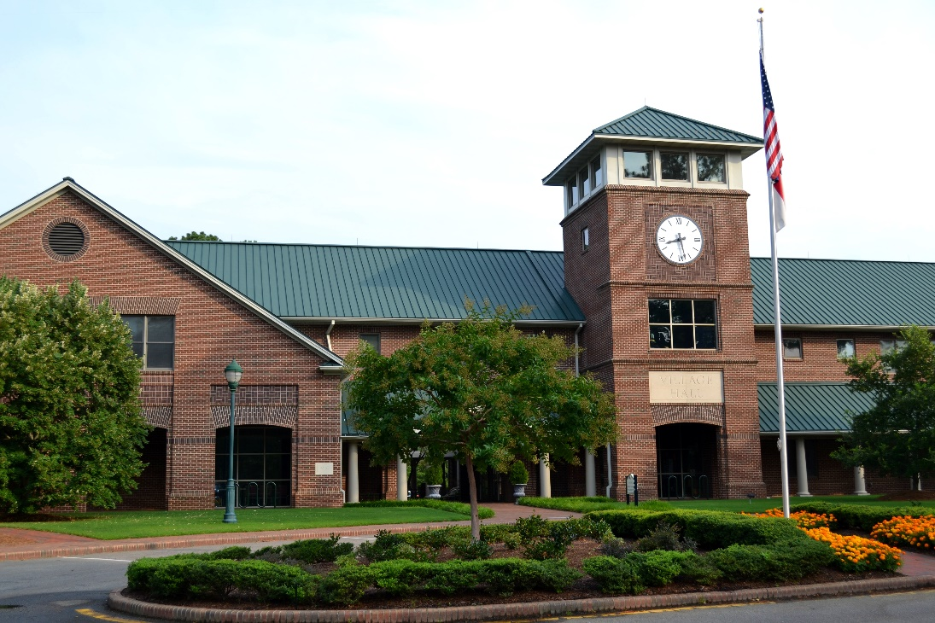
FY 2016 Village of Pinehurst
Strategic Plan Status Update As of December 31, 2015

Slide 2
FY 2016 Strategic Plan Status Update
Table of Contents
Village Council 3
Strategic objectives by balanced scorecard perspective 4
Overview of the status of FY 2016 initiatives 5
Initiative status update:
Customer perspective 6
Internal perspective 8
Employee perspective 9
Financial perspective 9

Slide 3
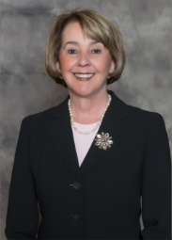
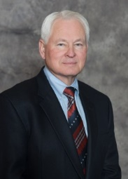
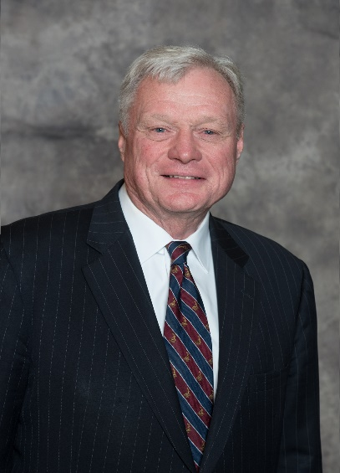
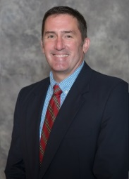
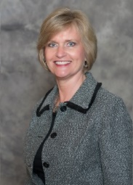
FY 2016 Strategic Plan Status Update
Village Council
Nancy Fiorillo,
Mayor
John Cashion,
Mayor ProTem
John Bouldry,
Treasurer
Clark Campbell,
Councilmember
Claire Berggren,
Councilmember
3

Slide 4
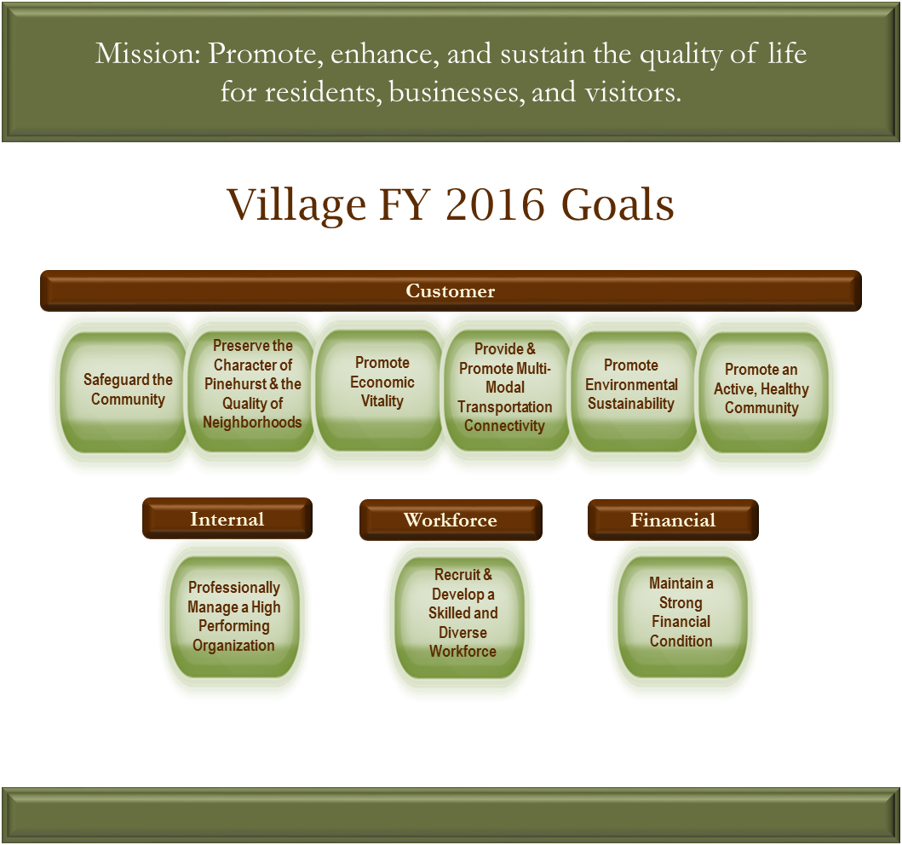
FY 2016 Strategic Plan Status Update
Strategic Objectives by Balanced Scorecard Perspective
History, Charm, & Southern Hospitality
4

Slide 5
FY 2016 Strategic Plan Status Update
Overview of the Status of Strategic Initiatives at December 31, 2015
There are a total of 37 Initiative Action Plans (IAPs) for FY 2016:
10 were carried over from FY 2015
27 were NEW IAPs for FY 2016
Staff recommends eliminating one IAP – Evaluate the use of solar energy for Village facilities
The following table indicates the status of IAPs at the end of Q2, FY 2016 (December 31, 2015):
IAP Status | # of IAPs at 12/31/15
IAP begins in a future quarter | 4
IAP is in progress and on schedule | 21
IAP is in progress, but not on schedule | 2
IAP has been completed | 10
Total | 37
5

Slide 6
FY 2016 Strategic Plan Status Update
Customer Perspective – Strategic Initiatives and Status
Goal | Strategic Objective | Initiative Action Plan (IAP) | Q1 Status | Q2 Status | Q2 Comments
Safeguard the Community | Deliver effective public safety services | Expand traffic pre-emption program to additional intersections in Village limits
 |  | Achieve national accreditation in the Fire Department
 |  | Evaluate alternative methods to proactively investigate and deter crime (BIRDIE) |  |  | Scheduled to present recommendations in Q3 and/or Q4
Preserve the Character of Pinehurst & the Quality of Neighborhoods | Maintain a high level of overall appearance of Pinehurst public spaces | Evaluate the consolidation of Streets & Grounds and Buildings & Grounds (BIRDIE) |  |  | This initiative is planned to extend into FY 2017
 | Achieve a high level of compliance with Village codes and ordinances | Implement the recommendations of the Code Enforcement BIRDIE Team |  |  | In progress of implementing public education components
 |  | Evaluate the code enforcement process (BIRDIE) (PY carryforward)
 | Maintain a high level of overall appearance of Pinehurst public spaces | Re-develop the Public Services campus |  |  | Scheduled to be substantively complete by June 30th
 |  | Develop an "Adopt a Plant Bed" program with the Beautification Committee (ACE)
Promote Economic Opportunity | Support economic and business development to meet the needs of Pinehurst residents and visitors | Support Pinehurst businesses through collaboration with Pinehurst Business Partners |  |  | This IAP calls for staff to attend one PBP meeting a quarter. Staff did not attend a meeting in Q2.
 |  | Incrementally expand the Village Center into Village Place/Rattlesnake Corridor
Legend
 | IAP begins in a future quarter
 | IAP is in progress and on schedule
 | IAP is in progress, but not on schedule
 | IAP has been completed
6

Slide 7
FY 2016 Strategic Plan Status Update
Customer Perspective – Strategic Initiatives and Status
Goal | Strategic Objective | Initiative Action Plan (IAP) | Q1 Status | Q2 Status | Q2 Comments
Provide & promote multi-modal transportation connectivity | Provide a safe and well-maintained network of streets, sidewalks, greenways, and bike paths | Conduct Midland Road corridor study (PY carryforward)
 | Provide a safe and well-maintained network of streets, sidewalks, greenways, and bike paths | Install sidewalks and/or greenways according to the Pedestrian Master Plan |  |  | Fell behind planned schedule to notify residents of proposed routes in Nov, but project will be completed by the end of the year as scheduled
 | Provide a safe and well-maintained network of streets, sidewalks, greenways, and bike paths | Install bike paths according to the Bicycle Master Plan |  |  | This initiative will need to be amended based on Council direction in February to not install the bicycle pavement markings (sharrows) as planned.
 | Provide for efficient traffic flow with minimal congestion | Make intersection improvements at McKenzie Rd and Hwy 5 and Barrett Rd and Hwy 5 |  |  | The scope of this project has been modified to not include improvements at Barrett Rd. and Hwy 5
Promote environmental sustainability | Conserve natural resources | Evaluate the use of solar energy for Village facilities |  |  | Staff recommends eliminating this initiative because HB245 did not pass and makes the initiative impossible to pursue as planned
Promote an active, healthy community | Provide adequate recreational facilities | Develop a comprehensive recommendation for a new Community Center Facility |  |  | Recommendation was presented to Council in January
 | Provide adequate recreational facilities | Develop Rassie Wicker Park facilities
 | Provide recreation programs and leisure activities for all ages | Establish a P&R internship program
Legend
 | IAP begins in a future quarter
 | IAP is in progress and on schedule
 | IAP is in progress, but not on schedule
 | IAP has been completed
7

Slide 8
FY 2016 Strategic Plan Status Update
Internal Perspective – Strategic Initiatives and Status
Goal | Strategic Objective | Initiative Action Plan (IAP) | Q1 Status | Q2 Status | Q2 Comments
Professionally Manage a High Performing Organization | Effectively communicate with customers in a timely and consistent manner | Develop and implement a corporate communications strategy for keeping the public informed, considering a more frequent newsletter publication and eblasts post-Council meetings (PY carryforward)
 | Continually improve the effectiveness and efficiency of key processes | Develop a contract management system (PY carryforward)
 |  | Continue to utilize the Baldrige excellence framework to improve organizational performance
 |  | Develop an organization wide complaint management process -VOP 311 (BIRDIE) |  |  | Scheduled to present recommendations in Q3
 |  | Develop a mechanism to share best practices between departments and evaluate the effectiveness (ACE)
 |  | Review key Village processes annually for opportunities for improvement
 |  | Complete Payment Card Industry (PCI) Compliance (PY carryforward)
 |  | Develop a method to evaluate the effectiveness of the Village Council (ACE) |  |  | Need Council direction on how/when to proceed with developing the planned performance appraisal tool
 |  | Develop a comprehensive orientation process for newly elected officials (PY carryforward)
Legend
 | IAP begins in a future quarter
 | IAP is in progress and on schedule
 | IAP is in progress, but not on schedule
 | IAP has been completed
8

Slide 9
FY 2016 Strategic Plan Status Update
Internal, Workforce, & Financial Perspectives - Strategic Initiatives and Status
Goal | Strategic Objective | Initiative Action Plan (IAP) | Q1 Status | Q2 Status | Q2 Comments
Professionally Manage a High Performing Organization | Generate collaborative solutions | Identify key partners and assign a Council liaison to each partner (PY carryforward) |  |  | Completed Q3 - January
 | Leverage technology to enhance Village operations | Increase capability to secure and monitor the Village computer network for legal compliance
 |  | Redesign Village website to add more functionality and integrate it with a mobile app (PY carryforward) |  |  | Scheduled to be completed in Q4
Recruit and develop a skilled and diverse workforce | Recruit, train, engage, and reward volunteers | Develop a comprehensive volunteer reward and recognition program (PY carryforward)
 |  | Develop a policy on volunteer and committee appointments (PY carryforward)
 | Train, develop, and engage employees | Review and revise the in-house TOPS training program (ACE) |  |  | Scheduled to begin in Q3
 | Reward and recognize employees | Implement a reward and recognition program (ACE)
Maintain a strong financial condition | Meet or exceed Village established financial targets | Evaluate alternative revenue sources for the Village
 |  | Implement the recommendations from the evaluation of the sale of Village owned land |  |  | Scheduled to begin in Q4 - deannex Juniper Lake Rd property
 |  | Implement BIRDIE Team recommendations to ensure the financial sustainability of the Harness Track
Legend
 | IAP begins in a future quarter
 | IAP is in progress and on schedule
 | IAP is in progress, but not on schedule
 | IAP has been completed
9

