Slide 1
FY 2016 Village of Pinehurst
Strategic Plan Status Update As of September 30, 2015

Slide 2
FY 2016 Strategic Plan Status Update
Table of Contents
Village Council 3
Strategic objectives by balanced scorecard perspective 4
Overview of the status of FY 2016 initiatives 5
Initiative status update:
Customer perspective 6
Internal perspective 8
Employee perspective 10
Financial perspective 10

Slide 3
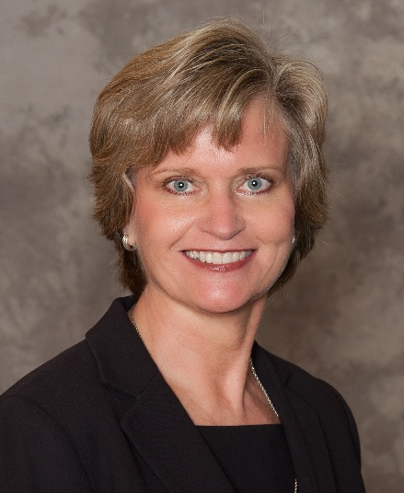
FY 2016 Strategic Plan Status Update
Village Council
Nancy Fiorillo,
Mayor
John Cashion,
Mayor ProTem
John Strickland,
Treasurer
Clark Campbell,
Councilmember
Claire Phillips,
Councilmember

Slide 4
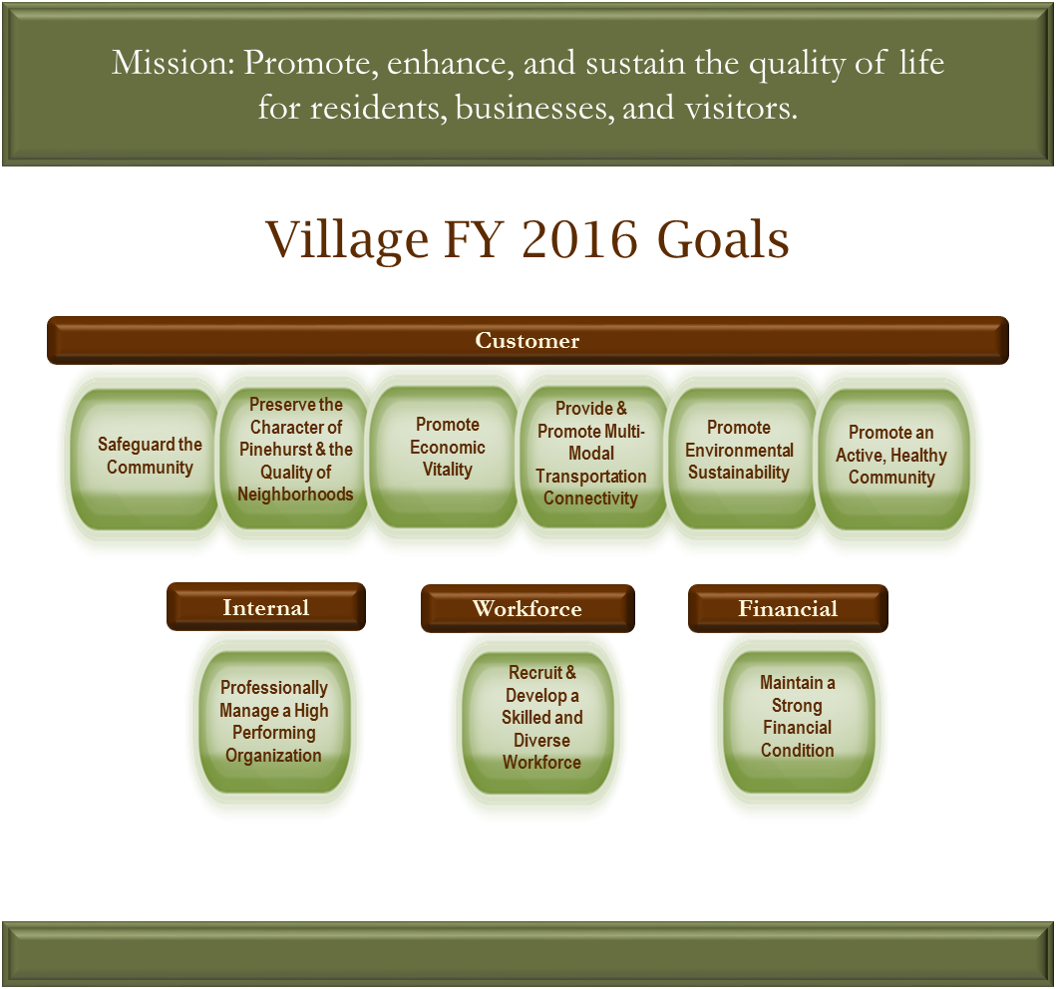
FY 2016 Strategic Plan Status Update
Strategic Objectives by Balanced Scorecard Perspective
History, Charm, & Southern Hospitality

Slide 5
FY 2016 Strategic Plan Status Update
Overview of the Status of Strategic Initiatives at September 30, 2015
There are a total of 37 Initiative Action Plans (IAPs) for FY 2016:
10 were carried over from FY 2015
27 were NEW IAPs for FY 2016
At the end of Q1, FY 2016 (September 30, 2015):
3 IAPs were completed
5 IAPs are scheduled to begin in a future quarter
29 IAPs were started, in progress, and on-schedule for completion according to timelines established

Slide 6
FY 2016 Strategic Plan Status Update
Customer Perspective – Strategic Initiatives and Status
Goal | Strategic Objective | Initiative Action Plan (IAP) | Q1 Status | Q1 Comments
Safeguard the Community | Deliver effective public safety services | Expand traffic pre-emption program to additional intersections in Village limits |  | Scheduled to complete in Q4
 |  | Achieve national accreditation in the Fire Department |  | Scheduled to submit documentation for peer review in Q3
 |  | Evaluate alternative methods to proactively investigate and deter crime (BIRDIE) |  | Scheduled to present recommendations in Q3
Preserve the Character of Pinehurst & the Quality of Neighborhoods | Maintain a high level of overall appearance of Pinehurst public spaces | Evaluate the consolidation of Streets & Grounds and Buildings & Grounds (BIRDIE) |  | BIRDIE team to begin evaluation in Q2
 | Achieve a high level of compliance with Village codes and ordinances | Implement the recommendations of the Code Enforcement BIRDIE Team |  | Technology implementation and friendly notifications began in Q1
 |  | Evaluate the code enforcement process (BIRDIE) (PY carryforward) |  | Completed in Q1
 | Maintain a high level of overall appearance of Pinehurst public spaces | Re-develop the Public Services campus |  | Scheduled to complete in Q4
 |  | Develop an "Adopt a Plant Bed" program with the Beautification Committee (ACE) | -- | Scheduled to begin in Q2
Promote Economic Opportunity | Support economic and business development to meet the needs of Pinehurst residents and visitors | Support Pinehurst businesses through collaboration wth Pinehurst Business Partners |  | On schedule
 |  | Incrementally expand the Village Center into Village Place/Rattlesnake Corridor |  | Council approved a concept in Q1
 | Completed
 | In progress and on schedule
-- | Initiative is scheduled to begin in a future quarter

Slide 7
FY 2016 Strategic Plan Status Update
Customer Perspective – Strategic Initiatives and Status
Goal | Strategic Objective | Initiative Action Plan (IAP) | Q1 Status | Q1 Comments
Provide & promote multi-modal transportation connectivity | Provide a safe and well-maintained network of streets, sidewalks, greenways, and bike paths | Conduct Midland Road corridor study (PY carryforward) |  | Scheduled to complete in Q4
 | Provide a safe and well-maintained network of streets, sidewalks, greenways, and bike paths | Install sidewalks and/or greenways according to the Pedestrian Master Plan |  | Scheduled to complete in Q4
 | Provide a safe and well-maintained network of streets, sidewalks, greenways, and bike paths | Install bike paths according to the Bicycle Master Plan |  | Scheduled to complete in Q4
 | Provide for efficient traffic flow with minimal congestion | Make intersection improvements at McKenzie Rd and Hwy 5 and Barrett Rd and Hwy 5 |  | Scheduled to complete in Q4
Promote environmental sustainability | Conserve natural resources | Evaluate the use of solar energy for Village facilities | -- | Scheduled to begin in Q3
Promote an active, healthy community | Provide adequate recreational facilities | Develop a comprehensive recommendation for a new Community Center Facility |  | Study team has been convened; scheduled to complete in Q2
 | Provide adequate recreational facilities | Develop Rassie Wicker Park facilities |  | RFP was sent out; Scheduled to complete in Q4
 | Provide recreation programs and leisure activities for all ages | Establish a P&R internship program |  | Developed program and will recruit for Summer 2016; Scheduled to complete in Q4
 | Completed
 | In progress and on schedule
-- | Initiative is scheduled to begin in a future quarter

Slide 8
FY 2016 Strategic Plan Status Update
Internal Perspective – Strategic Initiatives and Status
Goal | Strategic Objective | Initiative Action Plan (IAP) | Q1 Status | Q1 Comments
Professionally Manage a High Performing Organization | Effectively communicate with customers in a timely and consistent manner | Develop and implement a corporate communications strategy for keeping the public informed, considering a more frequent newsletter publication and eblasts post-Council meetings (PY carryforward) |  | Scheduled to evaluate effectiveness in Q2
 | Continually improve the effectiveness and efficiency of key processes | Develop a contract management system (PY carryforward) |  | Scheduled to evaluate effectiveness in Q2
 |  | Continue to utilize the Baldrige excellence framework to improve organizational performance |  | Completed site visit and obtained Level 3 Feedback Report; scheduled to prioritize OFIs from feedback in Q3
 |  | Develop an organization wide complaint management process -VOP 311 (BIRDIE) |  | BIRDIE team is on schedule to finalize recommendations by the end of Q3
 |  | Develop a mechanism to share best practices between departments and evaluate the effectiveness (ACE) |  | Scheduled to complete in Q3
 |  | Review key Village processes annually for opportunities for improvement |  | Scheduled to complete in Q4
 |  | Complete Payment Card Industry (PCI) Compliance (PY carryforward) |  | PCI compliance system was put into place in Q1
 |  | Develop a method to evaluate the effectiveness of the Village Council (ACE) | -- | Scheduled to begin in Q2, after Council discussion
 |  | Develop a comprehensive orientation process for newly elected officials (PY carryforward) |  | Scheduled to complete in Q3
 | Completed
 | In progress and on schedule
-- | Initiative is scheduled to begin in a future quarter

Slide 9
FY 2016 Strategic Plan Status Update
Internal Perspective (Continued) – Strategic Initiatives and Status
Goal | Strategic Objective | Initiative Action Plan (IAP) | Q1 Status | Q1 Comments
Professionally Manage a High Performing Organization | Generate collaborative solutions | Identify key partners and assign a Council liaison to each partner (PY carryforward) |  | Scheduled to evaluate effectiveness in Q2
 | Leverage technology to enhance Village operations | Increase capability to secure and monitor the Village computer network for legal compliance |  | Scheduled to complete in Q4
 |  | Redesign Village website to add more functionality and integrate it with a mobile app (PY carryforward) |  | Scheduled to complete in Q3
 | Completed
 | In progress and on schedule
-- | Initiative is scheduled to begin in a future quarter

Slide 10
FY 2016 Strategic Plan Status Update
Workforce & Financial Perspectives – Strategic Initiatives and Status
Goal | Strategic Objective | Initiative Action Plan (IAP) | Q1 Status | Q1 Comments
Recruit and develop a skilled and diverse workforce | Recruit, train, engage, and reward volunteers | Develop a comprehensive volunteer reward and recognition program (PY carryforward) |  | Scheduled to evaluate effectiveness in Q4
 |  | Develop a policy on volunteer and committee appointments (PY carryforward) |  | Completed in Q1
 | Train, develop, and engage employees | Review and revise the in-house TOPS training program (ACE) | -- | Scheduled to begin in Q3
 | Reward and recognize employees | Implement a reward and recognition program (ACE) |  | Scheduled to complete in Q2
Maintain a strong financial condition | Meet or exceed Village established financial targets | Evaluate alternative revenue sources for the Village |  | Draft report is prepared; scheduled to complete in Q2
 |  | Implement the recommendations from the evaluation of the sale of Village owned land | -- | Scheduled to begin in Q4 - deannex Juniper Lake Rd property
 |  | Implement BIRDIE Team recommendations to ensure the financial sustainability of the Harness Track |  | Implemented recommendations and tracking time and revenues for remainder of FY
 | Completed
 | In progress and on schedule
-- | Initiative is scheduled to begin in a future quarter

