Slide 1
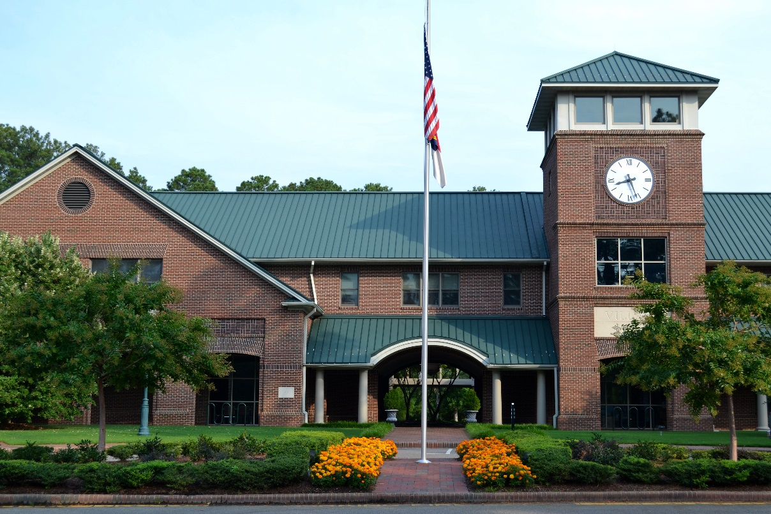
FY 2015 Village of Pinehurst
Annual Performance Report
Village Hall – 395 Magnolia Road
The Village of Pinehurst is a charming, vibrant community which reflects our rich history and traditions.
Notes:
This represents the first annual performance report since the Village Council’s adopted the Balanced Scorecard System for FY 2015.
ICMA Center for Performance Management has indicated that reporting performance results to both elected officials and the public is a best practice and this report meets their criteria.

Slide 2
FY 2015 Village of Pinehurst Annual Performance Report
Table of Contents
Village Council 3
Message from the Office of the Village Manager 4
Key Terms Used in this Report 6
Scoring of Scorecard Components 7
Council FY 2015 Goals 9
Composite Results by Balanced Scorecard Perspective:
Customer 11
Internal 18
Workforce 22
Financial 25
FY 2015 Strategic Initiatives 29
Notes:
Report includes information to help the Council and the public more easily understand the information contained herein, such as key terms and information on how performance results are scored. It is organized by BSC perspective to also make it easier to see how the Village is progressing in achieving its strategic objectives

Slide 3
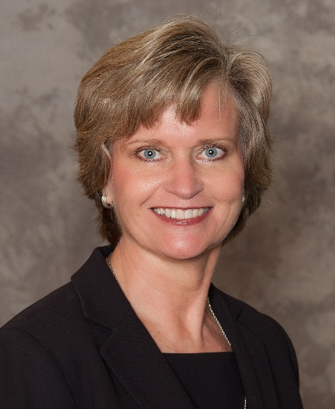
FY 2015 Village of Pinehurst Annual Performance Report
Village Council
Nancy Fiorillo,
Mayor
John Cashion,
Mayor ProTem
John Strickland,
Treasurer
Clark Campbell,
Councilmember
Claire Phillips,
Councilmember
Notes:
Thank the Village Council for your leadership and strategic direction to help staff truly focus on achieving results and delivering ever improving value and quality services to our customers

Slide 4
FY 2015 Village of Pinehurst Annual Performance Report
Message from the Office of the Village Manager
In Fiscal Year (FY) 2015, the Village Council adopted a Balanced Scorecard (BSC) Model to align activities and resources with organization goals and improve decision-making by providing performance feedback on critical priorities. This framework helps to balance strategic focus among four key perspective areas:
Customer, 2) Internal, 3) Workforce, and 4) Financial.
The FY 2015 BSC includes 15 Council Goals. The Corporate BSC and Department BSCs incorporate Village-level strategy into departmental-level strategy. This report includes the comprehensive results of performance on both the Corporate BSC and the department BSCs. Results are aggregated and composite scores are assigned to each of the 15 Council Goals and the four BSC perspectives. Performance measurement data included in this report has been reviewed and audited by management to ensure the accuracy of data being presented.
This Annual Performance Report also identifies which strategic initiatives were implemented, in progress, or not completed in FY 2015. These initiatives are aimed at improving performance levels where improvement is needed.
All scorecard components are scored using red, yellow, or green indicators based on established goals and red flag thresholds. Additional information about the scoring system is included within this report.
FY 2015 Performance Levels
The Village exceeded target performance levels for seven (7) Council Goals as a whole and performance for eight (8) Council Goals fell short of desired levels, but were within defined acceptable levels. This report includes comparisons to FY 2014 performance levels.
Notes:
BSC – 4 focus areas
18 strategic objectives
BSC cascades down to the department level and results are combined to identify “composite” performance results – scored using red, yellow, or green indicators
Show trend information where available
14 green, 3 yellow, and 1 red

Slide 5
FY 2015 Village of Pinehurst Annual Performance Report
Message from the Village Manager
Strategic Initiatives Completed
In FY 2015, Village staff completed 43 strategic initiatives, began working on 11 other initiatives that carried forward into FY 2016, and did not complete 12 initiatives that were originally planned to be completed during the year.
Some of the more significant accomplishments in FY 2015 included:
Implemented “One and Done” single day solid waste collection,
Increased transparency by posting video of Council meetings on vopnc.org and launching Open Village Hall, an online citizen engagement tool,
Secured dedicated indoor recreation space, “The Recreation Room,” on Rattlesnake Trail,
Constructed bocce ball and shuffleboard courts in Rassie Wicker Park,
Organized the Live After Five concert series,
Partnered with Given Memorial Library on the new Given Outpost,
Adopted the 2015 Comprehensive Pedestrian and Bicycle Master Plans,
Awards and Recognition
The Village was also recognized this year and received several prestigious awards: Safest Community in NC (2 years); Traffic Safety Community of the Year (8 years); Life Safety Achievement Award (12 years); Tree City USA (9 years); Certificate of Achievement in Financial Reporting (23 years); Distinguished Budget Presentation Award (7 years).
We are proud of what Village staff accomplished in FY 2015 and thank the Village Council for their continued leadership as staff strives to efficiently and effectively serve Village residents, businesses, and visitors.
Sincerely,
Jeff Sanborn Natalie Dean
Village Manager Assistant Village Manager
Notes:
This report also IDs strategic initiatives completed, in progress, or not completed
Significant accomplishments
Awards worth noting

Slide 6
FY 2015 Village of Pinehurst Annual Performance Report
Key Terms Used in this Report
Balanced Scorecard (BSC) – a strategic framework for translating broad, long-term organizational goals into a set of strategic operational objectives, measures, and initiatives.
BSC Perspectives – the four ‘lenses’ through which the organization views itself, including Customer, Internal, Employee and Financial.
Composite – a composite contains a set of performance measures that make up a composite or an index score, ranging from 0-10.
Council Goals– what the Village seeks to achieve to ensure long-term sustainability and to guide resource allocation.
Key Performance Indicators (KPIs) – indicators to gauge progress of strategic initiatives in affecting progress towards goals.
Strategic Initiative – a program, project, or activity that is designed to improve, introduce or sustain a scorecard component.

Slide 7
FY 2015 Village of Pinehurst Annual Performance Report
Scoring of Scorecard Components
Example
A 0-10 score is assigned to every scorecard component, with 0 being the lowest (red) and 10 being the highest (green). A yellow color-scoring occurs when actual performance is between the goal and the red flag thresholds.
Red flag thresholds for survey results were set as indicated in the chart.
Other red flag thresholds were determined by Senior Management in consultation with department heads.
Red Flag 85%
Score: 3.33
Goal 90%
Score: 6.67
Satisfaction Level Goal | Red Flag
95% - 100% | 90%
90% - 94% | 85%
81% - 89% | 80%
76% - 80% | 75%
71% - 75% | 70%
Less than 70% | Goal – 1%
% of residents who rate the overall quality of life as good or excellent
Actual Value: 94%
Score: 9.33
In this example, the goal is 90% and the red flag threshold, or the % that would indicate this measure should be evaluated, is 85%. Because the actual value was 94%, the score assigned to this measure is 9.33.
Notes:
All PMs (BSC and Dept Dashboards) are scored using this methodology, receiving a score of 1-10 based on actual results compared to the annual goal and the red flag thresholds.
REVIEW EXAMPLE
Red flag thresholds were standardized for survey responses (REVIEW CHART)

Slide 8
FY 2015 Village of Pinehurst Annual Performance Report
Scoring of Scorecard Components
To determine the Village’s performance related to a Council Goal, multiple performance measures are scored and a composite score is provided for the goal.
In addition, composite scores are also provided for each BSC perspective, which are identified below for FY 2015. In FY 2015, the Village received an overall composite score of 6.14 out of 10, compared to 7.51 in FY 2014.
Balanced Scorecard Perspective | FY 2014 Composite Score | FY 2015 Composite Score
Customer | 7.87 | 7.10
Internal | 8.83 | 6.88
Workforce | 7.60 | 4.31
Financial | 6.47 | 6.25
TOTAL | 7.51 | 6.14
Village-wide FY 2015
Composite Score: 6.14
Notes:
Overall
By perspective

Slide 9
FY 2015 Village of Pinehurst Annual Performance Report
Council BSC Goals
Notes:
As a reminder, you established 18 objectives in these 4 focus areas and this report will identify composite results by BSC perspective and then by Strategic objective
i.e. you will see the composite “Customer” score and then the composite score for each of the 6 SO in that perspective.

Slide 10
FY 2015 Village of Pinehurst Annual Performance Report
Composite Results by Balanced Scorecard Perspective

Slide 11
FY 2015 Village of Pinehurst Annual Performance Report
Customer
Perspective
Customer Perspective
Composite Score: 7.10
The FY 2015 composite score for the Customer Perspective includes all performance measures for the six Council Goals in this BSC perspective.

Slide 12
FY 2015 Village of Pinehurst Annual Performance Report
Safeguard the Community
Safeguard the Community Key Performance Indicators (KPIs) | FY 14 Actual | FY 15 Actual | FY 15 Goal
Total UCR crime rate per 1,000 residents | 10.24 | 7.86 | 12.00
% of residents whose overall feeling of safety in the Village is good or excellent | 96% | 97% | 96%
% of residents satisfied with the frequency of patrols in neighborhoods | 67% | 68% | 68%
% of businesses satisfied with the frequency of patrols in business districts | 95% | 90% | 90%
% of index offenses cleared | n/a | 47% | 55%
% of fire code violations corrected upon 90 day re-inspection | 96% | 86% | 91%
% of dispatched emergency calls with reaction time (dispatch to apparatus en-route) of 90 seconds or less | 67% | 76% | 75%
% of emergency response calls with response time of 6 minutes and 30 seconds or less for the first due apparatus | 66% | 73% | 75%
% of inspections that are compliant upon the initial inspection | 95% | 94% | 97%
Safeguard the Community
Composite Score: 6.28
In FY 2015, the Fire Department made several process improvements to increase their emergency response times that were close to or exceeded their goals (moving these KPIs from “red”). The Village’s crime rate declined and overall resident feeling of safety remained very strong. This year is the first year the Village began tracking the % of index offenses cleared on the BSC, with results near target levels. In the 2015 Community Survey, 93% of residents were satisfied with the Village’s efforts to prevent crimes, setting a new high national benchmark.
Notes:
5.36
Safest Community in NC – low crime rate
Fire response rates fell short of the red flag thresholds set by the Fire Chief.

Slide 13
FY 2015 Village of Pinehurst Annual Performance Report
Preserve the Character & Ambience of the Village
Preserve the Character & Ambience of the Village Key Performance Indicators (KPIs) | FY 14 Actual | FY 15 Actual | FY 15 Goal
% of residents satisfied with landscaping in medians and other public areas | 85% | 90% | 85%
% of residents who rate the overall appearance of the Village as good or excellent | 96% | 95% | 93%
% of residents who rate the overall quality of life as good or excellent | 94% | 94% | 92%
% of code violations resolved within 45 days of notification | 97% | 98% | 95%
% of residents satisfied with the enforcement of Village codes and ordinances | 52% | 57% | 68%
% or residents satisfied with planning and inspection services | 77% | 79% | 78%
Preserve the Character & Ambience of the Village
Composite Score: 7.61
94% or residents rated the overall quality of life as good or excellent, greatly exceeding the national average of 81%, and the Village’s goal. While the 2015 Community Survey indicated an improvement in resident satisfaction with the enforcement of codes and ordinances, it fell below the goal. It is worth noting that although only 57% of residents indicated they were satisfied with enforcement efforts, 28% of residents indicated they were neutral and only 15% indicated dissatisfaction.
Notes:
7.69
High levels of resident satisfaction with the appearance of the Village and the quality of life in Pinehurst

Slide 14
FY 2015 Village of Pinehurst Annual Performance Report
Promote Economic Opportunity
Promote Economic Opportunity Key Performance Indicators (KPIs) | FY 14 Actual | FY 15 Actual | FY 15 Goal
1st floor occupancy rate in the Village Center | 80% | 87% | 85%
% of businesses likely to recommend the Village as a business location | 87% | 90% | 87%
% of businesses satisfied with the Village's overall job of communicating with businesses | 62% | 75% | 65%
% of residents satisfied with the availability of parking downtown | 75% | 71% | 70%
# of parking spaces in the Village Center per 1,000 sq ft of commercial space | 2.28 | 2.31 | 2.27
# of unique visitors to online business resources | 1,479 | 462 | 1,000
% of businesses satisfied with the Village website | 77% | 76% | 75%
Promote Economic Opportunity
Composite Score: 8.08
The Village’s occupancy rate of 87% for first floor space in the Village Center surpassed the goal of 85% and exceeded occupancy rates for the past three years. Business satisfaction ratings improved over last year and exceeded the goals established. One area to watch is the utilization of online business resources, which fell short of desired levels in FY 2015.
Notes:
9.05
86% of businesses are likely to recommend the Village as a business location and occupancy rates in the Village Center improved because of the 2015 U.S. Open Championships.

Slide 15
FY 2015 Village of Pinehurst Annual Performance Report
Provide & Promote Safe Traffic & Pedestrian Mobility
Provide & Promote Safe Traffic & Pedestrian Mobility Key Performance Indicators (KPIs) | FY 14 Actual | FY 15 Actual | FY 15 Goal
Pavement condition rating | 82.9 | 82.9 | 82.9
# of lf of sidewalks, greenways, and bike paths constructed | 18,831 | 340 | 7,000
% of residents satisfied with the availability of pedestrian walkways & sidewalks | 46% | 43% | 36%
% of residents satisfied with the maintenance of streets in neighborhoods | 73% | 74% | 72%
% of collisions with an injury or fatality | 7% | 12% | 8%
% of miles of shoulder inspected and/or repaired | 15.5% | 11.8% | 9.5%
% of residents satisfied with maintenance of street signs/pavement markings | 81% | 84% | 82%
% of residents satisfied with maintenance of main Village street thoroughfares | 91% | 92% | 89%
# of miles of Village roadways resurfaced | 5 | 4.5 | 4
% of centerline miles of Village roadways resurfaced | 4.7% | 4.3% | 3.7%
Five year rolling average of the # of miles resurfaced | 5.7 | 5.4 | 4.5
% of residents satisfied with the adequacy of street lighting | 55% | 54% | 43%
Provide & Promote Safe Traffic & Pedestrian Mobility
Composite Score: 7.79
In FY 2015, the Village set a new high national benchmark with 92% of residents satisfied with the maintenance of main Village streets. Most all other KPIs related to traffic mobility exceeded the goals established. Due to the amount of time it took to get the 2015 Comprehensive Pedestrian and Bicycle Plans complete, the Village did not construct greenways as originally planned and only installed 340 linear feet of brick sidewalks on Ritter Road.
Notes:
8.56
Exceeded the goals for all performance measures under this objective except for street sign inspections, which was due to limited staff capacity.

Slide 16
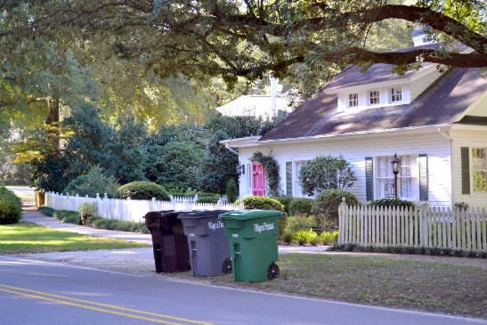
FY 2015 Village of Pinehurst Annual Performance Report
Protect the Environment
Protect the Environment Key Performance Indicators (KPIs) | FY 14 Actual | FY 15 Actual | FY 15 Goal
% of refused diverted from the landfill | 34% | 35% | 33%
% of residents satisfied with curbside recycling services | 92% | 92% | 92%
# of households participating in curbside recycling | 5,887 | 6,275 | 5,936
% of households participating in curbside recycling | 74% | 78% | 75%
# of tons recycled | 2,025 | 2,115 | 2,053
% of residents satisfied with the quality of stormwater runoff/management | 56% | 59% | 50%
Protect the Environment
Composite Score: 8.98
In 2015, the Village implemented the “One and Done” single day collection system. The change in the schedule didn’t impact satisfaction ratings with curbside recycling, where the Village equaled its prior year high national benchmark of 92% resident satisfaction. In addition, the village continues to divert a higher percentage of refuse from the landfill as recycling participation rates also continue to increase.
Residence with Solid Waste Carts
Notes:
9.09
Exceeded every goal in this objective and continue to have the highest satisfaction rating

Slide 17
FY 2015 Village of Pinehurst Annual Performance Report
Provide a Variety of Recreational & Cultural Opportunities
Provide a Variety of Recreational & Cultural Opportunities Key Performance Indicators (KPIs) | FY 14 Actual | FY 15 Actual | FY 15 Goal
% of residents satisfied with P&R programs | 72% | 72% | 75%
% of residents satisfied with Village sponsored cultural arts events | 65% | 63% | 65%
% of residents satisfied with P&R facilities | 77% | 74% | 80%
% of residents satisfied with quality of youth recreation programs | 51% | 50% | 51%
% of residents satisfied with the quality of adult recreation programs | 53% | 51% | 53%
% of capacity reached for stall rentals | 96% | 91% | 100%
# of days the Harness Track facilities are reserved | 125 | 25 | 38
% of customers satisfied with Harness Track facilities | 92% | 100% | 87%
# of days the facilities are reserved for non-equestrian uses | n/a | 13 | 53
# of weekdays the Fair Barn is used | 64 | 107 | 55
% of available days the Fair Barn is reserved | 55% | 56% | 37%
% of customers satisfied with the overall rental experience at the Fair Barn | n/a | 95% | 75%
% of residents satisfied with the quality of outdoor athletic fields and facilities | 68% | 66% | 76%
% of residents satisfied with the availability of outdoor athletic fields and facilities | 62% | 60% | 70%
Provide a Variety of Recreational & Cultural Opportunities
Composite Score: 3.96
The 2015 Community Survey satisfaction levels for several recreation KPIs were below the goals established. However, in all cases a large % of residents were neutral. There were actually low levels of dissatisfaction with Village sponsored cultural arts events (9%), P&R facilities (7%), youth recreation programs (10%), adult recreation programs (11%), quality of athletic fields and facilities (5%), and availability of athletic fields and facilities (8%). In 2015, we expected the HT facilities to be used for soccer and lacrosse practices, which did not transpire and resulted in not reaching the goal for the # of days the facility is reserved.

Slide 18
FY 2015 Village of Pinehurst Annual Performance Report
Internal
Perspective
Internal Perspective
Composite Score: 6.88
The FY 2015 composite score for the Internal Perspective includes all performance measures for the four Council Goals in this BSC perspective.

Slide 19
FY 2015 Village of Pinehurst Annual Performance Report
Enhance Customer Service
Enhance Customer Service Key Performance Indicators (KPIs) | FY 14 Actual | FY 15 Actual | FY 15 Goal
% of residents satisfied with customer service provided by Village employees | 82% | 83% | 82%
% of residents satisfied with access to the Mayor/Village Council | 43% | 44% | 50%
% of residents satisfied with the effectiveness of appointed boards/commissions | 60% | 64% | 60%
% of residents satisfied with levels of public involvement in decision making | 43% | 44% | 50%
% of residents satisfied with Village Hall reception desk service | 90% | 90% | 91%
% of residents satisfied with Village communication with residents | 88% | 82% | 82%
% of agendas with supporting materials posted to the VOP website 5 days in advance of the meetings | 61% | 100% | 100%
% of residents satisfied with Village efforts to keep residents informed about local issues | 79% | 72% | 75%
% of employees who rate the quality of procurement services as excellent or good | 86% | 78% | 86%
% of employees who rate the timeliness of procurement services as excellent or good | 85% | 78% | 85%
% of employees who rate the timeliness of HR services as excellent or good | 80% | 70% | 83%
% of businesses satisfied with fire prevention inspection services | 95% | 93% | 80%
% of inspections completed within one business day | 95% | 99% | 99%
Enhance Customer Service
Composite Score: 5.19
While satisfaction levels with access to the Council and levels of public involvement were below targeted levels, there were only 14% dissatisfied (with 42% neutral). Lower employee satisfaction with the quality and timeliness of procurement services is likely due to new contract management procedures instituted this year that have somewhat slowed the process, but provides for more effective overall contract management.

Slide 20
FY 2015 Village of Pinehurst Annual Performance Report
Enhance Customer Service - CONTINUED
Enhance Customer Service Key Performance Indicators (KPIs) - CONTINUED | FY 14 Actual | FY 15 Actual | FY 15 Goal
% of businesses satisfied with building inspections | 100% | 89% | 95%
% of residents satisfied with Public Services "request for service" | 87% | 73% | 84%
% of time the Technical Review Committee responds to comments within 3 weeks | 79% | 100% | 90%
% of facilities inspected quarterly | 87% | 64% | 85%
% of B&G work order requests closed within 14 days | 81% | 83% | 85%
% of fleet maintenance PMs performed on time | 74% | 86% | 90%
% of work order requests completed in two days | 81% | 82% | 65%
% of rolling stock available | 97% | 98% | 99%
# of failed transactions for critical Intranet/SharePoint applications | 3 | 11 | 20
% of IT help desk tickets closed within 2 days | 88% | 88% | 90%
Average # of days to close IT help desk tickets | 0.51 | 0.45 | 0.75
% of residents satisfied with the Village website | 62% | 67% | 75%
# of app downloads | n/a | 314 | 300
Enhance Customer Service
Composite Score: 5.19
Village internal services staff in B&G and Fleet worked diligently this year to improve their responsiveness to internal work order requests as shown in the improvement of their KPIs for work orders and PMs completed. While the Village did not reach target levels for a few satisfaction ratings, there was very little dissatisfaction in the following two areas: business dissatisfaction with building inspections (0%) and resident dissatisfaction with the Village website (4%). Resident dissatisfaction with PS “request for service” is 17% and is something that we should probably evaluate and may be partially related to the “One and Done” rollout.

Slide 21
FY 2015 Village of Pinehurst Annual Performance Report
Other Internal Perspective Objectives
Continuously Improve Processes Key Performance Indicators (KPIs) | FY 14 Actual | FY 15 Actual | FY 15 Goal
Full-time equivalents per million $ of revenue | 7.79 | 8.1 | 8.41
Continuously Improve Processes
Composite Score: 7.32
Develop Collaborative Solutions Key Performance Indicators (KPIs) | FY 14 Actual | FY 15 Actual | FY 15 Goal
# of new collaborative initiatives developed | 14 | 22 | 15
Develop Collaborative Solutions
Composite Score: 10
Meet Legal & Regulatory Key Performance Indicators (KPIs) | FY 14 Actual | FY 15 Actual | FY 15 Goal
% compliance with the NC Local Government Budget and Fiscal Control Act | 100% | 100% | 100%
% of CJIS compliance issues addressed | n/a | 35.71% | 100%
This year, the IT department worked diligently to address the Criminal Justice Information Services(CJIS) compliance areas that the Village is required to address. Due to staff turnover, additional changes to the federal mandates, and a better understanding of the complexity and extent of the requirements, only 5 of the 14 issues were addressed prior to year end.
Meet Legal & Regulatory Requirements
Composite Score: 5

Slide 22
FY 2015 Village of Pinehurst Annual Performance Report
Workforce
Perspective
Workforce Perspective
Composite Score: 4.31
The FY 2015 composite score for the Workforce Perspective includes all performance measures for the two Council Goals in this BSC perspective.

Slide 23
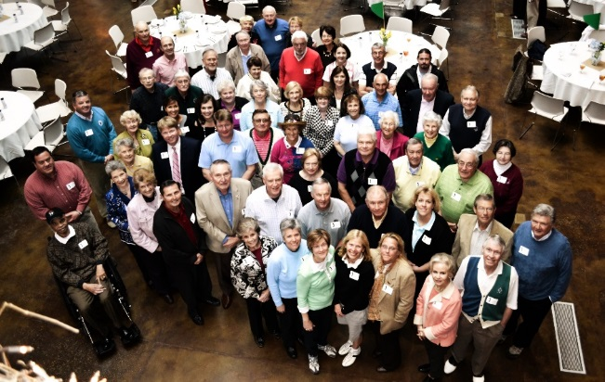
FY 2015 Village of Pinehurst Annual Performance Report
Increase Volunteer Engagement
Optimize Volunteer Engagement Key Performance Indicators (KPIs) | FY 14 Actual | FY 15 Actual | FY 15 Goal
% of volunteers satisfied with the volunteer experience | 86% | 95% | 91%
# of volunteer applications received | 55 | 19 | 30
% of volunteers who agree they are offered training and development to enhance their skills | 67% | 63% | 65%
# of Citizen on Patrol (COP) volunteer hours | 3,722 | 2,319 | 2,700
Optimize Volunteer Engagement
Composite Score: 3.58
In 2015, the % of volunteers satisfied with the volunteer experience increased considerably and exceeded the goal. However, the Village did not receive as many volunteer applications as expected. The large # of applications received in FY 2014 is due to the recruitment of new volunteers for the Welcome Center when it relocated to the Theatre Building. In addition, the COP volunteers didn’t work as many hours as projected. The COP volunteer time is the equivalent of a full time position and equates to nearly $42,000.
Volunteers at the Volunteer Luncheon

Slide 24
FY 2015 Village of Pinehurst Annual Performance Report
Recruit & Retain a Skilled & Diverse Workforce
Recruit & Retain a Skilled and Diverse Workforce Key Performance Indicators (KPIs) | FY 14 Actual | FY 15 Actual | FY 15 Goal
% of EEs who are satisfied with their job | 87% | 92% | 90%
Employee turnover rate | 8% | 14% | 10%
% of employees who agree they are recognized for contributing to the VOP Mission | 68% | 71% | 78%
# of lost time workers’ compensation claims | 4 | 0 | 0
% of employees who agree they are paid fairly | 66% | 56% | 67%
Average # of days to recruit from requisition to start date | 70 | 75 | 55
% of positions reviewed for salary range competiveness | 86% | 36% | 35%
% of EEs who agree they are offered training and development to enhance their skills | 87% | 85% | 89%
% of Fire Department employees who complete advanced training programs of 30 or more hours per year | 30% | 60% | 33%
Recruit & Retain a Skilled & Diverse Workforce
Composite Score: 5.04
Employee job satisfaction improved in FY 2015 and exceeded the Village’s goal. However other employee agreement ratings fell below target levels. The turnover rate also increased considerably in FY 2015, due to planned retirements (which the Village expects to see continue in FY 2016). Excluding these, the turnover rate would have been 8%. The average # of days to recruit exceeded last year and the target due to a few positions taking longer to fill that included the Planning Director, a solid waste equipment operator, and a few police positions.

Slide 25
FY 2015 Village of Pinehurst Annual Performance Report
Financial
Perspective
Financial Perspective
Composite Score: 6.25
The FY 2015 composite score for the Financial Perspective includes all performance measures for the three Council Goals in this BSC perspective.

Slide 26
FY 2015 Village of Pinehurst Annual Performance Report
Provide Value for Tax Dollars
Provide Value for Tax Dollars Key Performance Indicators (KPIs) | FY 14 Actual | FY 15 Actual | FY 15 Goal
% of residents satisfied with the value received for taxes paid | 69% | 63% | 70%
General Fund operating expenditures as a % of operating revenues | 87% | 88% | 89%
# of financial transactions processed per Finance Technician FTE per month | 942 | 1,322 | 950
Ratio of HR staff per 100 employees | 1.90 | 1.90 | 1.89
# of calls dispatched per sworn police officer | 552 | 532 | 600
# of initial fire inspections completed per inspector per month | 12 | 19 | 12
Building inspections completed per inspector FTE per day | 11 | 12 | 9
% of roadways rated 85 or better | 60% | 60% | 60%
Yard waste tons collected per FTE | 416 | 488 | 633
# of program and athletics participants per Recreation Coordinator FTE | 1,615 | 1,861 | 2,100
# of PMs completed per fleet FTE per month | 5.29 | 3.78 | 4
# of IT work orders completed per FTE per month | 31 | 23 | 30
Provide Value for Tax Dollars
Composite Score: 6.6
The 2015 Community Survey indicated declining satisfaction with the value of tax dollars, however only 7% were dissatisfied with the remaining either neutral or expressed no opinion. While the yard waste tons collected per FTE were higher in FY 2015 due to “One and Done,” it did not reach the levels anticipated. The IT work orders completed per FTE per month were below anticipated levels due to fewer work orders being completed.

Slide 27
FY 2015 Village of Pinehurst Annual Performance Report
Maintain a Strong Financial Condition
Maintain a Strong Financial Condition Key Performance Indicators (KPIs) | FY 14 Actual | FY 15 Actual | FY 15 Goal
Bond rating | 86 | 86 | 86
Debt service expenditures as a % of total budgeted expenditures | 2.7% | 2.8% | 3.0%
Unassigned GF fund balance as a % of actual expenditures | 26% | 31% | 27%
Fund Balance Appropriated during the year (less the rollforward) as a % of original budget | 4.67% | 0.06% | 3.00%
Cumulative # of enrolled ACH vendors | 125 | 130 | 125
% of total purchases made using p-cards | 15% | 16% | 12%
Estimated average cost per building inspection | $41.86 | $40.23 | $51.00
Household refuse collection cost per household per year | $189.79 | $178.11 | $191.00
Harness Track operating revenues as a % of operating expenditures | 52% | 54% | 52%
Fair Barn operating revenues as a % of operating expenditures | 94% | 92% | 102%
Maintain Strong Financial Condition
Composite Score: 8.50
The Village continued to remain in a strong financial condition in FY 2015. Fair Barn operating revenues as a % of expenditures fell below the target level due to the $48,553 provided in event discounts. Had the Village charged for these events, the % would have been 112% and exceeded the Council goal.

Slide 28
FY 2015 Village of Pinehurst Annual Performance Report
Invest in Capital
Invest in Capital Key Performance Indicators (KPIs) | FY 14 Actual | FY 15 Actual | FY 15 Goal
Capital asset condition ratio | 57% | 55% | 60%
% of computers and servers less than 5 years old | 98% | 96% | 100%
Invest in Capital
Composite Score: 3.66
The capital asset condition ratio fell below the stated goal of 60% in FY 2015 and in FY 2014. This indicates the Village should continue to monitor the condition of capital assets and ensure they are replaced in a timely fashion.

Slide 29
FY 2015 Village of Pinehurst Annual Performance Report
FY 2015
Strategic Initiatives
In FY 2015, Village staff completed 43 strategic initiatives, began working on 12 other initiatives that carried forward into FY 2016, and did not complete 11 initiatives that were originally planned to be completed during the year.

Slide 30
FY 2015 Village of Pinehurst Annual Performance Report
Strategic Initiatives Completed in FY 2015
Council Goal | Completed Initiatives in FY 2015
Safeguard the Community | Partner with others to offer public safety education programs
 | Implement Command Central module to analyze crime data
 | Evaluate how to proactively investigate drug and related property crimes activities
Preserve the Character & Ambience of the Village | Develop a rating system for the appearance of public areas in partnership with CAC
Promote Economic Opportunity | Evaluate opportunities to redesign and enhance current Public Services site
Provide & Promote Safe Traffic & Pedestrian Mobility | Improve adequacy of street lighting in neighborhoods
 | Develop an alternative transportation master plan to identify locations of greenways, sidewalks, and bike paths
 | Conduct a Village-wide evaluation of street lighting needs
 | Conduct the HWY5/Barrett Road Intersection Study
 | Install Opticom traffic device to improve response time and ensure safety of emergency personnel
 | Continue to work with NCDOT to identify a viable long-term solution for the traffic circle

Slide 31
FY 2015 Village of Pinehurst Annual Performance Report
Strategic Initiatives Completed in FY 2015
Council Goal | Completed Initiatives in FY 2015
Provide & Promote Safe Traffic & Pedestrian Mobility (Continued) | Develop and implement a public education campaign for roadway safety
 | Collaborate with other jurisdictions to develop a Highway 211 corridor plan
 | Extend sidewalk and walkway system
 | Implement a GPS based software solution to track and analyze data on infrastructure maintenance and route management
Protect the Environment | Evaluate alternatives to reduce energy consumption for street lighting
 | Implement single-day collection system with automated yard debris
 | Increase public education on the benefits of recycling to encourage greater participation
Provide a Variety of Recreational and Cultural Opportunities | Expand cultural arts events in Village parks
 | Develop park facilities
 | Support the Given Memorial Library Expansion
 | Evaluate the need for indoor recreation facilities (BIRDIE)

Slide 32
FY 2015 Village of Pinehurst Annual Performance Report
Strategic Initiatives Completed in FY 2015
Council Goal | Completed Initiatives in FY 2015
Enhance Customer Service | Develop and implement a corporate communications strategy for keeping the public informed, considering a more frequent newsletter publication and eblasts post-Council meetings
 | Develop post event service survey for Fair Barn
 | Post video and/or recordings of Council meetings on the Village website
Continuously Improve Processes | Develop a contract management system
 | Centralize data access and promote business process analysis by maintaining, supporting, and utilizing SharePoint more effectively
 | Implement an E-Crash traffic accident solution
Develop Collaborative Solutions | Partner with organizations to host cultural events at the Fair Barn
 | Implement online engagement tools to seek citizen input on Council related decisions
 | Identify key partners and assign a Council liaison to each partner
Optimize Volunteer Engagement | Develop an annual training program for volunteer committees
 | Develop a policy on volunteer and committee appointments

Slide 33
FY 2015 Village of Pinehurst Annual Performance Report
Strategic Initiatives Completed in FY 2015
Council Goal | Completed Initiatives in FY 2015
Recruit & Retain a Skilled & Diverse Workforce | Perform a formal compensation study to review current practices, pay scales, & position descriptions
 | Offer in-house training through the TOPS program and conduct the annual Employee Academy
 | Implement selected recommendations from the Compensation Study
Provide Value for Tax Dollars | Oversee the annexation of Cotswold
Maintain a Strong Financial Condition | Develop an annual budget that meets or exceeds established financial targets
 | Maximize use of the Fair Barn
 | Evaluate alternatives to make the Harness Track financially sustainable (BIRDIE)
Invest in Capital | Maintain VOP buildings and facilities
 | Effectively maintain current capital assets
 | Continue to enhance the Village roadways with the Annual Street Resurfacing Program

Slide 34
FY 2015 Village of Pinehurst Annual Performance Report
Strategic Initiatives in Progress at Year End
Council Goal | Initiatives in Progress at Year End | Status Update
Safeguard the Community | Achieve national accreditation in the Fire Department | In progress at the end of Q1, FY 2016.
Promote Economic Opportunity | Incrementally expand Village Center into Village Place/Rattlesnake Corridor | Completed in Q1, FY 2016.
Preserve the Character & Ambience of the Village | Evaluate the code enforcement process (BIRDIE) | Completed in Q1, FY 2016.
Provide & Promote Safe Traffic & Pedestrian Mobility | Conduct the Midland Road Corridor Study | Completed in Q1, FY 2016.
Enhance Customer Service | Redesign Village website to add more functionality and integrate it with a mobile app | In progress at the end of Q1, FY 2016.
Continuously Improve Processes | Create a comprehensive orientation process for newly elected officials | In progress at the end of Q1, FY 2016.
Meet Legal & Regulatory Requirements | Complete Payment Card Industry (PCI) Compliance Project | Completed in October 2015.
 | Increase capability to secure and monitor the Village network for legal compliance | In progress at the end of Q1, FY 2016.
Optimize Volunteer Engagement | Develop a comprehensive volunteer reward and recognition program | Completed in Q1, FY 2016.
Recruit & Retain a Skilled & Diverse Workforce | Develop a Village wide employee recognition program | Completed in Q1, FY 2016.
Invest in Capital | Evaluate the sale of Village-owned land | In progress at the end of Q1, FY 2016.

Slide 35
FY 2015 Village of Pinehurst Annual Performance Report
For more information, please contact:
Natalie Dean, Assistant Village Manager
ndean@vopnc.org
910-295-1900 ext. 1103
395 Magnolia Road
Pinehurst, NC 28374
www.vopnc.org

