Slide 1
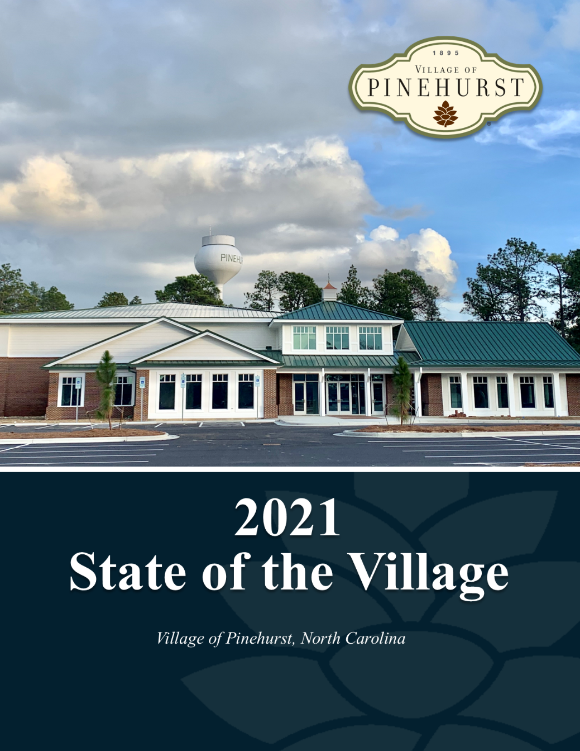
FY 2021 State of the Village Report Presentation

Slide 2
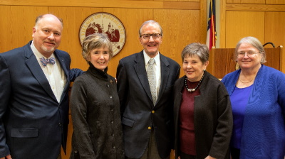
FY 2021 State of the Village Report Presentation
Village Council
Councilmember Kevin Drum, Treasurer Lydia Boesch, Mayor John Strickland,
Mayor Pro Tem Judy Davis, and Councilmember Jane Hogeman (From left to right)

Slide 3
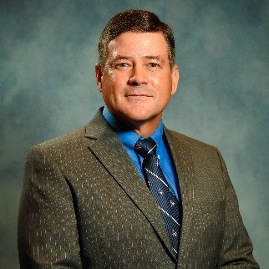
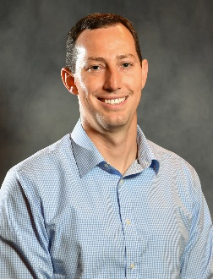
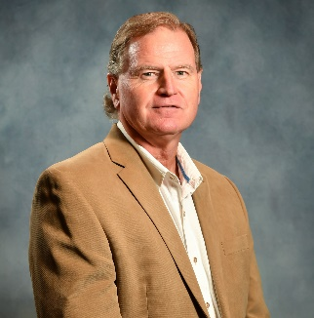
FY 2021 State of the Village Report Presentation
Message from the Office of the Village Manager
The Village of Pinehurst had another successful year working to accomplish the objectives set forth by the Village Council. Overall, we exceeded our FY 2021 goals. We establish annual goals and objectives to ensure we achieve the Village’s mission to “Promote, enhance, and sustain the quality of life for residents, businesses, and visitors.” This year, 99% of residents and 100% of businesses rate the overall quality of life in the Village as excellent or good.
Using the Baldrige Performance Excellence Framework, we have successfully created a culture of continuous improvement at the Village. Each year we pursue opportunities for improvement and innovation aimed to enhance resident and business satisfaction levels as measured in our annual surveys.
This year, we focused efforts on eight initiative action plans and our residents and businesses continue to indicate high satisfaction levels with the vast majority of Village services. Since 2013, the Village has seen improved resident satisfaction in 86% of our service areas and we currently exceed the national averages in 48 out of 49 service areas. In FY 2021, we achieved the highest annual satisfaction ratings in the US in the ETC DirectionFinder Benchmark Group for 12 areas, matching FY2020 as the most achieved in one year for the Village.
We are extremely proud of our staff’s accomplishments and efforts to continuously improve the efficiency and effectiveness of Village services to promote, enhance, and sustain the quality of life for our customers.
Jeff Sanborn
Village Manager
Doug Willardson
Assistant Village Manager
Jeff Batton
Assistant Village Manager

Slide 4
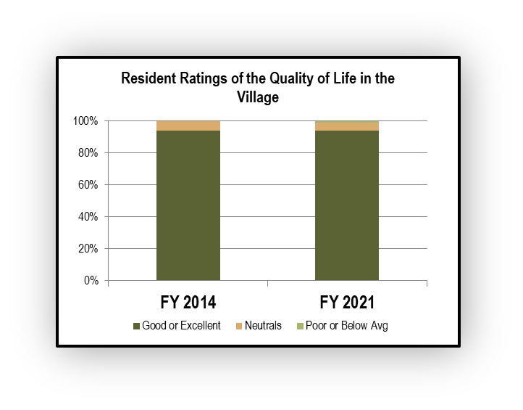
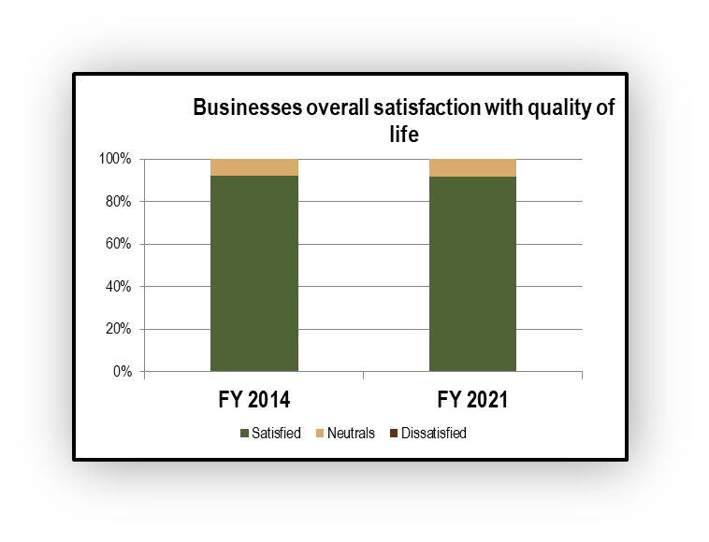
FY 2021 State of the Village Report Presentation
Quality of Life
99% of residents are satisfied with the quality of life in the Village
100% of businesses are satisfied with the quality of life in the Village

Slide 5
FY 2021 State of the Village Report Presentation
National High Satisfaction Ratings Achieved
Since 2012, the Village has achieved the highest annual satisfaction rating in the United States for 21 different areas in our benchmark group
Highest National Satisfaction Rating Service Area | FY 2012 | FY 2013 | FY 2014 | FY 2015 | FY 2016 | FY 2017 | FY 2018 | FY 2019 | FY 2020 | FY 2021
Village efforts to prevent crime | 92% |  |  | 93% | 93% | 92% | 91% | 91% |  | 87%
Maintenance of major streets in the village | 88% | 89% | 91% | 92% | 91% |  | 90%
Curbside recycling services | 92% |  | 92% | 92% |  | 94% | 96%
Residential trash collection services |  | 94% | 96% |  |  |  | 96% |  | 95%
Village communications |  |  | 88% |  |  |  |  |  |  | 82%
Feeling of safety in your neighborhood during the day |  |  |  | 99%
Overall appearance of the Village |  |  |  |  | 95% | 95% |  |  | 96% | 94%
The Village as a place to retire |  |  |  |  | 94% |  | 94% |  | 96% | 95%
Yard waste collection services |  |  |  |  | 89% | 90% | 91% |  | 91% | 91%
Number of parks in your community |  |  |  |  |  | 90%

Slide 6
FY 2021 State of the Village Report Presentation
National High Satisfaction Ratings Achieved
Since 2012, the Village has achieved the highest annual satisfaction rating in the United States for 21 different areas in our benchmark group
Highest National Satisfaction Rating Service Area | FY 2012 | FY 2013 | FY 2014 | FY 2015 | FY 2016 | FY 2017 | FY 2018 | FY 2019 | FY 2020 | FY 2021
Effectiveness of Village Manager & appointed staff |  |  |  |  |  |  | 68% |  | 76%
Landscaping in medians and other public areas |  |  |  |  |  |  |  | 90% | 93% | 94%
Fire Services |  |  |  |  |  |  |  |  | 96% | 96%
Overall feeling of safety |  |  |  |  |  |  |  |  | 97% | 96%
Enforcing sign regulations |  |  |  |  |  |  |  |  | 66%
Maintenance/preservation of Downtown |  |  |  |  |  |  |  |  | 91% | 91%
Opportunities to participate in local government |  |  |  |  |  |  |  |  | 65%
Quality of leadership provided by elected officials |  |  |  |  |  |  |  |  | 75%
Customer Service provided by Village employees |  |  |  |  |  |  |  |  |  | 86%
Cleanliness of streets & other public areas |  |  |  |  |  |  |  |  |  | 92%
Police Services |  |  |  |  |  |  |  |  |  | 94%

Slide 7
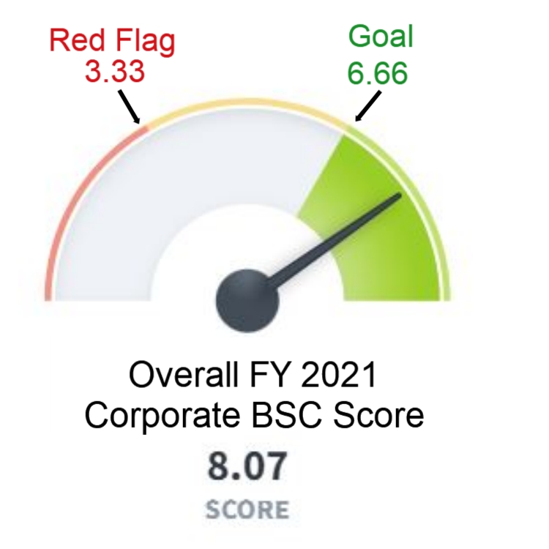
FY 2021 State of the Village Report Presentation
Overall, in FY 2021, the Village exceeded the goals set forth by the Village Council on the FY 2021 Balanced Scorecard

Slide 8
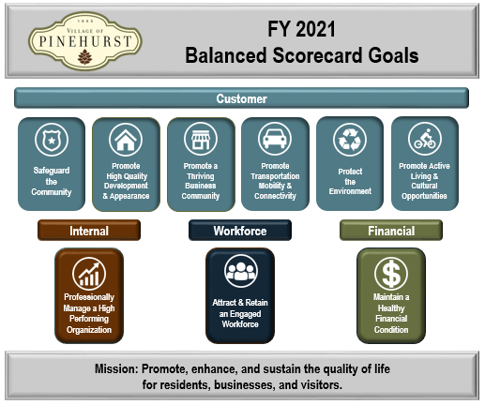
FY 2021 State of the Village Report Presentation

Slide 9
FY 2021 State of the Village Report Presentation
Balanced Scorecard Results by Goal
Noticeable improvement in performance for FY 2021
Noticeable decline in performance for FY 2021

Slide 10
Customer Focus

Slide 11
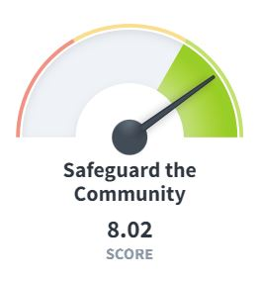
FY 2021 State of the Village Report Presentation
Safeguard the Community
Key Performance Indicators | FY 2019 | FY 2020 | FY 2021 | FY 2021 Goal
% of residents satisfied with fire services | 100% | 100% | 100% | 95%
% of residents satisfied with how quickly fire personnel respond to emergencies | 99% | 99% | 98% | 95%
Fire incident rates per 1,000 population served | 0.26 | 0.05 | 0.66 | 0.35
% of residents whose overall feeling of safety in the Village is good or excellent | 99% | 100% | 99% | 95%
% of residents satisfied with police services | 98% | 98% | 98% | 95%
Crime rate per 1,000 residents | 41.48 | 26.67 | 36 | 47
The Fire Department has focused efforts on improving reaction and response times. Reaction time is the time from when a dispatcher alerts the department of an emergency to when the unit leaves the station. In FY 2021, the department achieved a reaction time of 90 seconds or less 91% of the time.
In FY 2021, saw a sharp increase in fire incident rates from the previous year. In raw numbers, the Fire Department responded to a total of 13 fire incidents in FY 2021 compared to one incident in FY2020. The 0.66 rate per 1,000 is consistent with historical incident rates.
The Fire Department received Reaccredited Agency status with the Commission on Fire Accreditation International (CFAI) for meeting the criteria established through the CFAI’s voluntary self-assessment and accreditation program.

Slide 12
FY 2021 State of the Village Report Presentation
Promote a Thriving Business Community
Key Performance Indicators | FY 2018 | FY 2019 | FY 2020 | FY 2020 Goal
% of businesses likely to recommend the Village as a business location | 88% | 93% | 92% | 90%
Non-residential development saw a strong year with 24 non-residential permits issued at a value of $63,277,042 which is 11 less permits than in FY 2020 but value of properties permitted increased by more than $26 million.
In this year’s business survey, 93% indicated they were satisfied with the overall quality of services provided to their business by the Village, 98% indicated satisfaction with customer services provided by Village employees compared to other places they operated a business in the past, and 99% were satisfied with the overall image of the Village.
The Welcome Center hosted Shop Small this Season/Small Business Saturday to encourage local shopping and dining in November. The event drew more than 500 visitors to the Welcome Center with receipts spent at Village businesses totaling over $45,000. This represents a 27% increase in visitors and a 45% increase in receipts from FY2019. The event included three gift baskets totaling over $4,000 of prizes donated by local merchants.

Slide 13
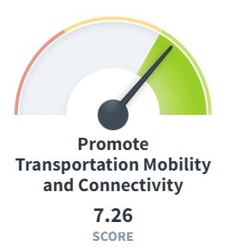
FY 2021 State of the Village Report Presentation
Promote Transportation Mobility and Connectivity
Key Performance Indicators | FY 2019 | FY 2020 | FY 2021 | FY 2021 Goal
% of residents satisfied with the availability of walkways | 70% | 71% | 67% | 70%
% of residents satisfied with availability of greenway / walking trails | 94% | 94% | 92% | 90%
# of collisions per 1,000 population | 39 | 34 | 34 | 45
% of residents satisfied with the adequacy of street lighting | 75% | 70% | 71% | 70%
% of residents satisfied with street and right of way maintenance | 85% | 89% | 88% | 85%
The Village provides and maintains pedestrian facilities throughout the municipal limits. In FY 2021, the Village maintained a total of 7.6 miles of greenway trails and 19.33 lane miles of walkways.
In FY 2021, 4.5 miles of the Village’s 108 centerline miles of Village roadways were resurfaced. Of the residents participating in the annual Resident Community, 83% indicated satisfaction with maintenance of streets in neighborhoods around the Village of Pinehurst in FY2021.
Notes:
Overall score= 6.75
Review each of the KPIs
Review bullet points

Slide 14
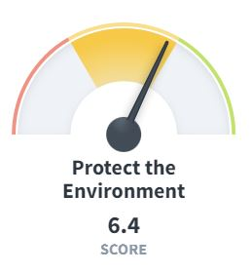
FY 2021 State of the Village Report Presentation
Protect the Environment
Key Performance Indicators | FY 2019 | FY 2020 | FY 2021 | FY 2021 Goal
% of residents satisfied with stormwater management | 77% | 84% | 83% | 80%
% of residents satisfied with solid waste services | 92% | 96% | 96% | 95%
% of residents satisfied with promotion of natural resource conservation | 86% | 92% | 89% | 90%
% of refuse diverted from the landfill | 27% | 20% | 15% | 22%
Stormwater has risen as a priority for residents over the last several years. The RFQ for Engineering Services to assist in developing a comprehensive stormwater master plan was sent out in June. All stormwater complaints are submitted through MY VOP and last year, staff ensured 97% of these complaints were addressed on time.
Over the last year, the Public Services Department reported 100% of solid waste routes were completed on schedule. With the use of the MY VOP app, staff responded to 1.04 solid waste complaints per 1,000 collection points for the fiscal year and 99% of the complaints were addressed on time.
Notes:
Overall score= 6.68
Review each of the KPIs
Review bullet points

Slide 15
FY 2021 State of the Village Report Presentation
Promote Active Living and Cultural Opportunities
Key Performance Indicators | FY 2019 | FY 2020 | FY 2021 | FY 2021 Goal
% of residents satisfied with P&R programs | 98% | 99% | 98% | 95%
% of residents satisfied with P&R facilities | 96% | 99% | 98% | 95%
% of residents satisfied with Village sponsored cultural arts events | 93% | 93% | 94% | 95%
Adult and youth participation is roughly equal between athletic and recreation programs hosted by the Village of Pinehurst. In total, 182 athletic and recreation programs were offered to our community during 2021.
Recreation programs saw another successful year with 95% of residents satisfied with the quality of youth recreation programs and 93% satisfied with the quality of adult recreation programs. Over the last year, the department served 4,085 participants in athletic and recreation programs.
After a long hiatus due to COVID-19, our outdoor group gathering special events started up again in May with Live After 5.
Notes:
Overall score= 7.82
Review each of the KPIs
Review bullet points

Slide 16
Internal Focus

Slide 17
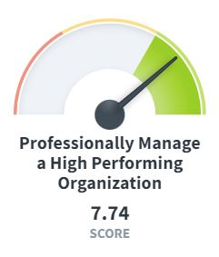
FY 2021 State of the Village Report Presentation
Professionally Manage a High Performing Organization
Key Performance Indicators | FY 2019 | FY 2020 | FY 2021 | FY 2021 Goal
% of residents satisfied with Village communications | 93% | 96% | 97% | 95%
% of residents satisfied with the level of public involvement in local decisions | 85% | 92% | 87% | 85%
% of residents satisfied with customer service provided by VOP staff | 97% | 98% | 98% | 95%
% of residents satisfied with the value received for taxes paid | 90% | 93% | 93% | 90%
% of depreciable life remaining on assets | 42% | 40% | 45% | 50%
To leverage technology, the Village continues to implement the GIS Strategic Plan including training that began in the Fall of 2021. The Village also continued its journey using the Baldrige Excellence Framework and were awarded a site visit for the National Malcom Baldridge Award in October 2020.
The MY VOP mobile app allows residents to stay involved in Village affairs. At the close of FY 2021, there were approximately 5,186 downloads of the app. Village staff addressed over 4,500 requests and complaints received through MY VOP, responding to 98% of those complaints within desired time frames.
Notes:
Overall score= 7.25
Review each of the KPIs
Review bullet points

Slide 18
Workforce Focus

Slide 19
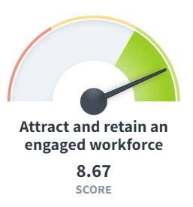
FY 2021 State of the Village Report Presentation
Attract & Retain an Engaged Workforce
Key Performance Indicators | FY 2019 | FY 2020 | FY 2021 | FY 2021 Goal
% of employees who agree that overall they like their job | 97% | 99% | 98% | 95%
% of volunteers who agree that overall they like their role | 100% | 100% | 98% | 95%
This year, the Village continued working on a Workforce Learning and Development initiative action plan. The initiative’s goal is to develop workforce skills and abilities through a new Learning and Development System and incorporate the system into the succession planning process.
Vacancies filled with internal candidates can be an indicator of successfully developing the workforce. This year, 47% of vacancies were filled with internal candidates, exceeding the goal of 35%.
The reward and recognition program is a key way to show appreciation for employees and volunteers who provide exceptional service. The FY2021 employee survey indicated that 93% of participating employees were satisfied with the VOP’s employee recognition programs and 93% of volunteers agreed they are recognized for their performance.

Slide 20
Financial Focus

Slide 21
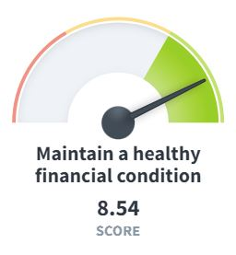
FY 2021 State of the Village Report Presentation
Maintain a Healthy Financial Condition
Key Performance Indicators | FY 2019 | FY 2020 | FY 2021 | FY 2021 Goal
Total General Fund fund balance as a % of actual expenditures | 45% | 64% | 69% | 30%
General Fund Operating Margin | 86% | 80% | 82% | 86%
General Fund Debt Service Ratio | 1.82% | 1.80% | 0.75% | 10.00%
The Village continues to maintain a healthy financial condition through diligent financial oversight.
Once again, the Village received a clean audit opinion by external auditors, proving diligent financial management.
For the 28th consecutive year, the Village received the GFOA Certificate of Achievement for Excellence in Financial Reporting.
For the 14th consecutive year, the Village received the GFOA Distinguished Budget Award.

Slide 22
FY 2021 State of the Village Report Presentation
Conclusion
The Village is a High Performing Organization, as demonstrated by:
99% of residents and 100% of businesses indicate the quality of life as good or excellent
93% of residents are satisfied with the value received for taxes paid
The Village has achieved the highest national satisfaction ratings of our benchmark group in 21 areas in the last 8 years- 12 areas in FY 2021 alone
The Village exceeds 48 of 49 US average satisfaction ratings
Resident satisfaction ratings have improved in 86% of our service areas since 2013
Our workforce indicates high levels of engagement
The Village is in excellent financial condition

Slide 23
FY 2021 State of the Village Report Presentation
Awards and Special Recognitions
The Village is recognized as a High Performing Organization through awards and other special recognitions. Here are just a few received in FY 2021!

Slide 24
FY 2021 State of the Village Report Presentation
For more information, please contact:
Matt McKirahan, Organizational Performance Director
mmckirahan@vopnc.org
910-295-1900 ext. 1104
395 Magnolia Road
Pinehurst, NC 28374
www.vopnc.org

